Slide 1

Android prompt user input dialog
Pemrograman Mobile
Dosen: Dwi Sunaryono

Slide 2
Android Input Dialog
A dialog is a small window that prompts the user to make a decision or enter additional information. A dialog does not fill the screen and is normally used for modal events that require users to take an action before they can proceed. The Dialog class is the base class for dialogs.
Creating a input dialog in android involves below steps
Create layout for input dialog
Inflating layout and initialize AlertDialog

Slide 3
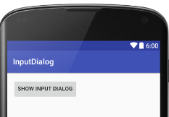
Creating input dialog layout
Buat Proyek baru dan tambahkan tombol untuk menampilkan input dialog, contoh
<LinearLayout xmlns:android="http://schemas.android.com/apk/res/android"
xmlns:tools="http://schemas.android.com/tools"
android:layout_width="match_parent"
android:layout_height="match_parent"
android:orientation="vertical"
android:padding="@dimen/activity_vertical_margin" >
<Button
android:id="@+id/button"
android:layout_width="wrap_content"
android:layout_height="wrap_content"
android:text="Show Input Dialog" />
<TextView
android:id="@+id/result"
android:layout_width="wrap_content"
android:layout_height="wrap_content"
android:textAppearance="?android:attr/textAppearanceLarge" />
</LinearLayout>

Slide 4
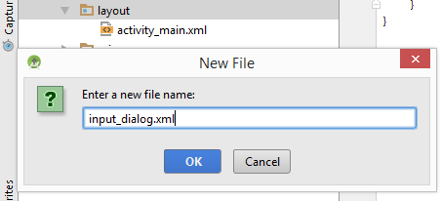
Input dialog layout (input_dialog.xml)
Input dialog layout is composed of a TextView to hint user what to enter, and a EditText to enter values.

Slide 5
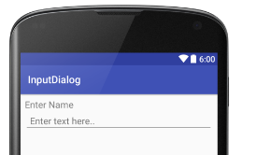
Input dialog layout (input_dialog.xml)
<?xml version="1.0" encoding="utf-8"?>
<LinearLayout
xmlns:android="http://schemas.android.com/apk/res/android"
android:layout_width="match_parent"
android:layout_height="wrap_content"
android:orientation="vertical"
android:padding="10dp">
<TextView
android:layout_width="wrap_content"
android:layout_height="wrap_content"
android:textAppearance="?android:attr/textAppearanceMedium"
android:text="Enter Name"
android:id="@+id/textView" />
<EditText
android:id="@+id/edittext"
android:layout_width="fill_parent"
android:layout_height="wrap_content"
android:hint="Enter text here.."
android:padding="10dp" />
</LinearLayout>

Slide 6
Membuat Dialog
Mengambil Layout dengan LayoutInflater, kemudian mengambil View dari inflate yang telah diambil dari setting xml dialog, setelah itu buat dialog dengan AlertDialogBuilder dan setting dialog tsb
private void tampil_input(){
LayoutInflater li = LayoutInflater.from(this);
View inputnya = li.inflate(R.layout.input_dialog,null);
AlertDialog.Builder dialognya = new
AlertDialog.Builder(this);
dialognya.setView(inputnya);
txtinput = (EditText) inputnya.findViewById(R.id.edittext);
dialognya
.setCancelable(false)
.setPositiveButton("Ok",oknya)
.setNegativeButton("Batal",oknya);
dialognya.show();
}

Slide 7
Menangani Aksi Dialog
.setPositiveButton("Ok",oknya)
.setNegativeButton("Batal",oknya);
Ditangani dengan operasi dari DialogInterface.OnClick
DialogInterface.OnClickListener oknya = new DialogInterface.OnClickListener() {
@Override
public void onClick(DialogInterface dialog, int which) {
//positif -1 negatif -2
switch (which) {
case -1: hasilnya.setText(txtinput.getText().toString());
break;
case -2:
break;
}
}
};
Kelemahan dari operasi penangan yang terpisah adalah harus membuat
variable global antara layout dengan dialognya

Slide 8
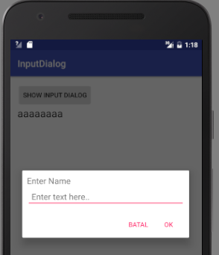
public class MainActivity extends AppCompatActivity {
private TextView hasilnya;
private EditText txtinput;
@Override
protected void onCreate(Bundle savedInstanceState) {
super.onCreate(savedInstanceState);
setContentView(R.layout.activity_main);
hasilnya = (TextView) findViewById(R.id.result);
Button btn = (Button) findViewById(R.id.button);
btn.setOnClickListener(op);
}
View.OnClickListener op = new View.OnClickListener() {
@Override
public void onClick(View v) {
switch (v.getId()) {
case R.id.button:
tampil_input();
break;
}
}
};
Variabel Global

Slide 9
private void tampil_input(){
LayoutInflater li = LayoutInflater.from(this);
View inputnya = li.inflate(R.layout.input_dialog,null);
AlertDialog.Builder dialognya = new AlertDialog.Builder(this);
dialognya.setView(inputnya);
txtinput = (EditText) inputnya.findViewById(R.id.edittext);
dialognya
.setCancelable(false)
.setPositiveButton("Ok",oknya)
.setNegativeButton("Batal",oknya);
dialognya.show();
}
DialogInterface.OnClickListener oknya = new DialogInterface.OnClickListener() {
@Override
public void onClick(DialogInterface dialog, int which) {
//positif -1 negatif -2
switch (which) {
case -1: hasilnya.setText(txtinput.getText().toString());
break;
case -2:
break;
}
}
};
}

